Slide 2
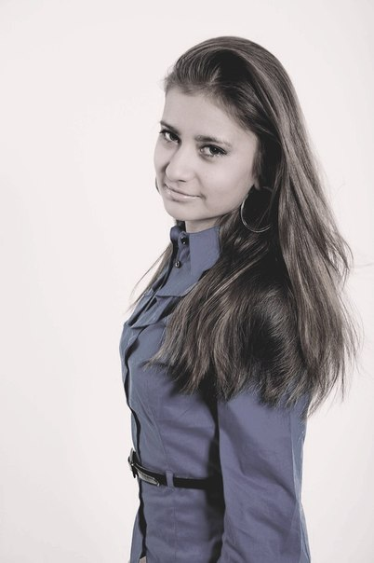
The creators of the magazine
Liliya Kalganova
Catherine Piyak
Kseniya Kosturya
Tania Grechka
Dariya Korzh

Slide 3
Outline
National Mining University (p.3)
The department of Foreign Languages (p.4)
Ticket to the future (p.5)
Everybody has dreams (p.7)
My feelings after the performance (p.8)
Achieve your goals (p.9)
Some inspiring numbers to get you on your bike (p.10)
Do you love to sing or dance? Do you love sports or aerobics? You have to come here! (p.11)
Handmade as medicine for the soul (p.12)
Work and Travel USA (p.13)

Slide 4
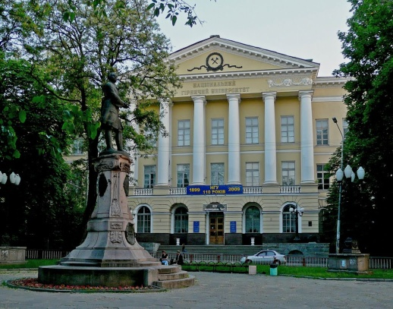
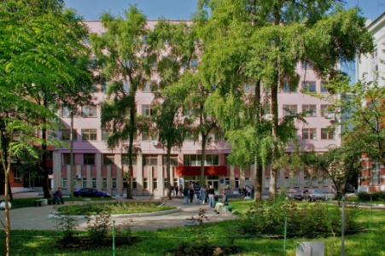
National Mining University
June 16, 2014 is an important date for the National Mining University (NMU) because this educational institution celebrates 115 years of its existence. The National Mining University is one of the leading establishments of higher education in Ukraine. According to the ratings of UNESCO it achieved 6th position among the 200 Top universities in Ukraine in 2009. The history of the university is very exciting and interesting, but I want to tell about nowadays.
NMU is a university of a dream! Each student can find a speciality for his/her soul. That's why so many people are applying to NMU.
NMU gives you joy, knowledge, friendship, faith in yourself, confidence in the future, bright life. Teachers have excellent theoretical knowledge as well as good practical experience. Many graduates have reached considerable ‘heights’ in their life thanks to experience and knowledge which they got in the university, thanks to the efforts of teachers.
Every year interior and exterior of its buildings and educational system are updated and strengthened. NMU keeps up with the time!

Slide 5
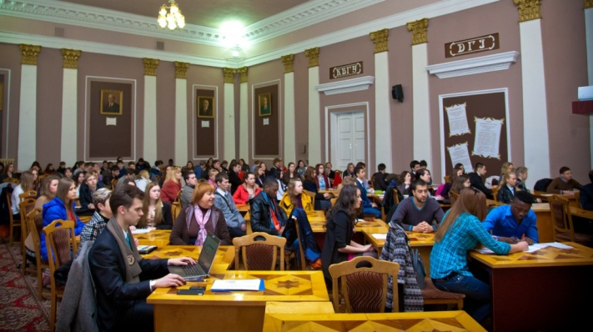
The department of Foreign Languages
Department of Foreign Languages ​​is a recognized center for the exchange of experience and a venue for international conferences and seminars on topical issues of teaching foreign languages.
At the department of foreign languages ​​there are:
Language Training Center;
English drama theater;
Club "Traveling across Ukraine and in the world."
Teachers of foreign languages ​​will open the world of English, German and French languages ​​for bachelors, masters, specialists and graduate students of different specialties.

Slide 6
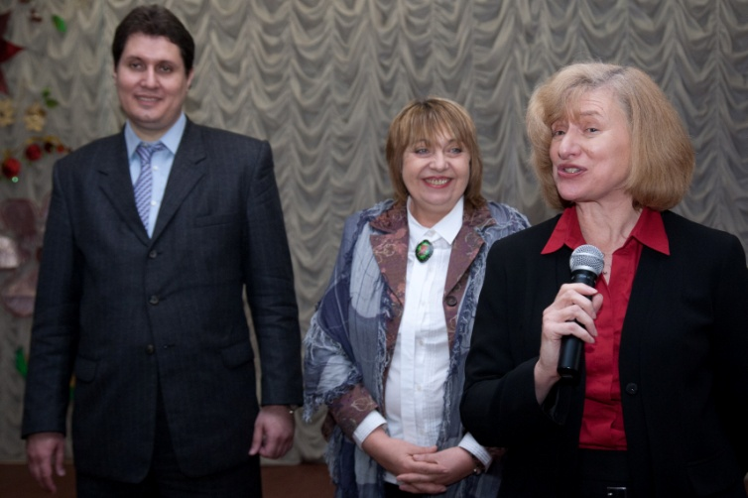
TICKET TO THE FUTURE
Nowadays, quite a number of people believe that the world is too gray and boring. Teenagers, students and even young workers cannot say unhesitatingly that they live fun, that they know how to spend this evening and how they want to live. Alas, but the percentage of dissatisfied in their work is growing. Everyone thought about it, but I am not sure that everyone tried to prevent it. There are things in the world which can change our life at any time. For example, education does not give us the ability to choose. If you learn to be an engineer, then, alas, an engineer and worked all his life (well, maybe not all, there are exceptions). If you have an engineering education, you will be working as an engineer for life. Is there anything that can help you forsake the wrong way? Yes! I can assure you of that. Friends, experience, a variety of skills are things that can change your life.

Slide 7
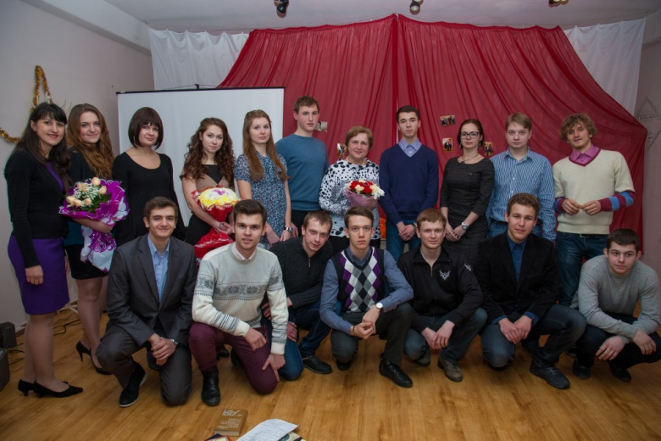
I want to tell you about my little experience. I am a first year student and my life is so various that I can confidently look in my future and aware of all my opportunities and chances for success. In addition to daily studying at the University, I am visiting the Language Training Center at NMU, where I am learning English. Also there I am an actress of the English drama theatre (operating at the center), I am participating in a variety recreational, developmental and educational programs, events and conferences. Earlier I could not think that studying in this center is so interesting. Many friendly, creative and courageous people with the most incredible ideas in their heads come to class and make your life a little brighter.
Language training center gives people a chance not only to learn a foreign language, but also to express themselves. Here you will learn not only how to communicate in a foreign language, but also to debate, to explain, to dispute, to congratulate, to show feelings and so on. Here you can speak with foreigners and people who live or have lived abroad and you can ask them all sorts of questions and get some experience.
Now think of the things that I have told you. Friends, experience, skills! Come to the Center to learn English and you will get a chance or "ticket" in the secure future.

Slide 8
Everybody has dreams
Have you ever thought about how many dreams you have? A person may have one, two, three or more dreams. What is more important that all people dream without exception. Somebody does not even think about it, and somebody cannot live a day without ‘flying in dreams’. Why do people do it? Maybe it makes them happy? Consciously or unconsciously, every day people do something that makes them happy. It can be anything: going to the movies, or buy chocolate balloon, etc. Someone cannot understand it and ask: ‘Why? What for?’
These are the questions which actors of English drama theatre and students of Language training center heard many times. Young people, in spite of age gap differences, in specialities and outlook on life, have at least two things which combine them. They are love to English and theater. What do they answer the abovementioned questions about their participation in the performances?
“Playing in the theater gives emotions. I can’t describe those feelings that I experience while playing. It’s really amazing“ (Julia Sveshnikova)
“For me it is always a sea of ​​emotions, inspiration and joy. I am honored to stand on the same stage with talented friends” (Oleksandra Saitova)
“Every day you see your study, home, work , etc. And when you come to the theater you do what you want and how you want. It is valuable experience” (Valera Bezkorovainy)
“This is a wonderful chance to discover a new talent” (Andrey Parfenenko)
"Emotions! This is the first that I can say about performances. It all makes me happy. Isn’t it the most important thing?” (Catherine Piyak)

Slide 9
My feelings after the performance
Recently I played a role in a popular performance “Pride and Prejudice” by Jane Austen. It was my first experience as an actress. What can I say about emotions and feelings? It is a delight, flying, adrenaline. It’s just fantastic. It is impossible to describe in words the game during the performance. It is important to feel, pass through yourself, through your heart and soul. And also this is disturbing excitement: the strongest feeling before the show. I ‘had flown up’ to the maximum before I got into the stage, but when I saw an audience I calmed down at once. And when the show is over and you go to the bow, everybody applauds, then your friends and family hug you, say greeting words and express their enthusiasm. It is the highest award for the months of rehearsals and inner feelings. I want to thank my supervisor S.I. Kostrytskaya and guys for this performance. I hope it is not our last play. And we will show you magnificent performances next year.

Slide 10
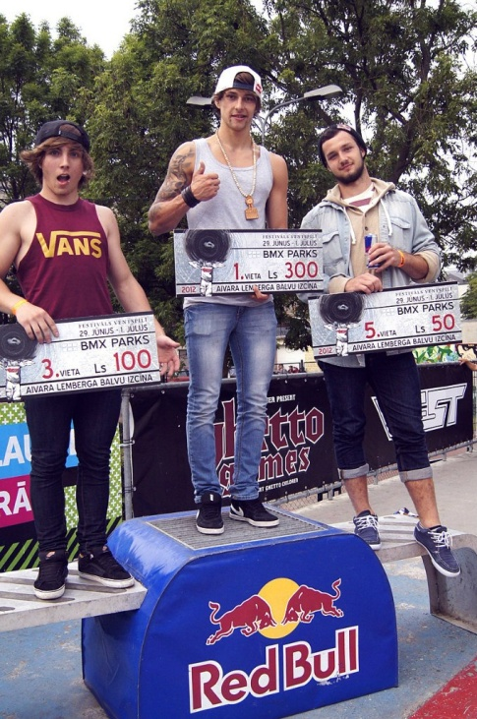
Achieve your goals
We never know exactly what will happen to us in the future. We do not know who we will be, what we will do, what we will love and hate. But there are things in our life that everybody must achieve. I mean our life goals. One of the most important things on the way of achieving goals is confidence. And one of the best ways to become a confident person is to get inspiration from example, idol.
This article is about a man who knows what he wants to achieve and how to be confident. Vasily Lukyanenko is one of the best riders in Europe, a rising star in BMX and a student of the National Mining University. Vasily graciously answered all my questions which I thought would interest you as well.
- Why did you decide to do this?
- When I was 14 I wanted to do something extreme. On TV I saw how the guys were riding bicycles. It was exciting! I tried to ride by BMX and since that time it has become my hobby.
- Of course, your workout is extreme and dangerous. How often do you get injured?
- Not so often. I use special protective equipment.
- I know that you are a multiple winner of many competitions both in Ukraine and abroad. Tell me what have you already achieved?
- Last year I won 2nd place in major competitions in Russia. I also had 8th place in Spain, 5th place in Latvia. There were several first places in Ukraine, too.
- You are training a lot, learning a foreign language, participating in various competitions. As I understand you want to associate with the sport all your future life?
- I'll ride as long as health would allow me to do it.
- Do you have a motto?
- Achieving the goals!
After talking with Vasya, I can say that his popularity is not far away. So, be confident, set goals and achieve them!

Slide 11
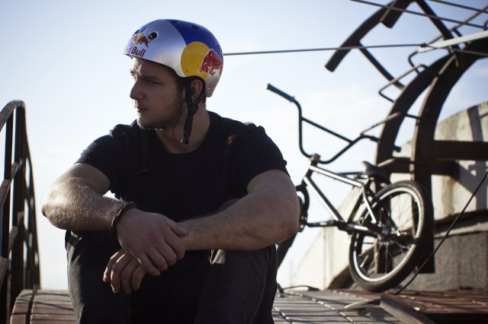
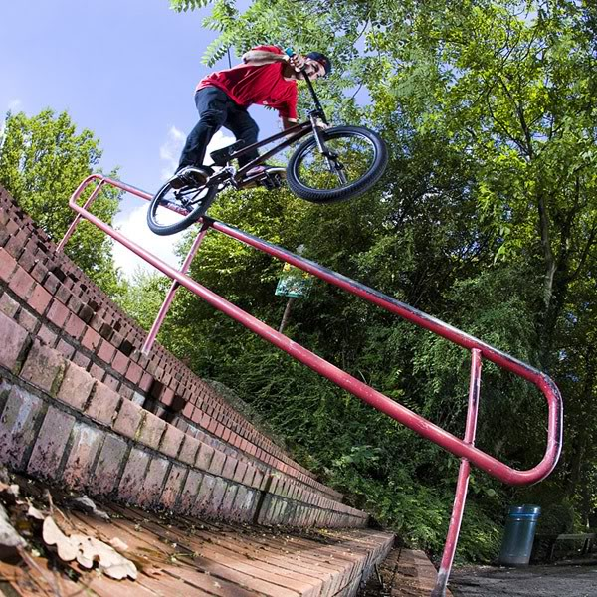
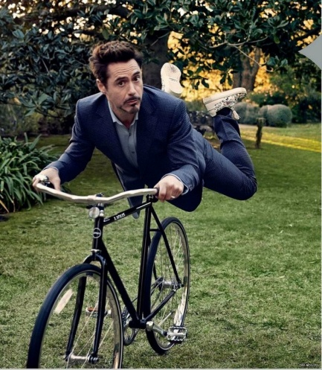
Some inspiring numbers to get you on your bike
You don't need us to tell you that getting on your bike is a good idea, you can do the maths for yourself. With the physical, financial and environmental benefits, you'll soon find out cycling really does add up! The following figures relate to cycling in the UK:
20 times less dangerous than not cycling
97% chance of not getting rained on
Twice as fast as a car in traffic
4 miles is the average cycle commute
£382 a year to boost the economy for every new cyclist
At current rates, 60% of the population will be obese by 2050
A bike takes 6.2 tonnes less carbon than a car to make
10 bikes can be parked in the space it takes to park one car
A Zone 3 Oyster card commute in London costs £5.80 a day
Cycling in London has increased by 91% since 2003
A middle-aged cyclist is typically as fit as someone 10 years younger
16 mile commute = 800 calories. That's 4 bags of crisps or 12 fig rolls or 6 bananas or 6 cans of coke
60% of car trips are shorter than 5 miles

Slide 12
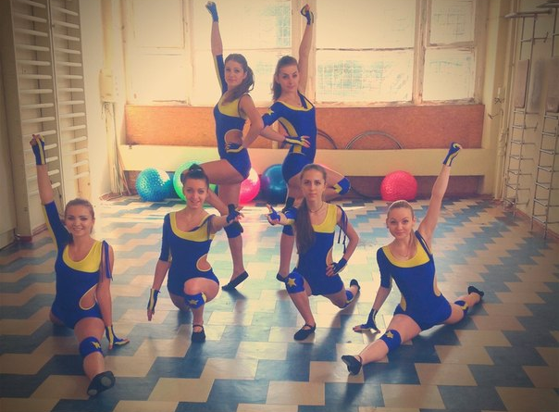
Do you love to sing or dance? Do you love sports or aerobics? You have to come here!
Students of National Mining University have all possibilities for personal development. Playing sports is of great importance in this case. You can do aerobics, pilates, tennis, football, cheerleading in the university.
Workouts are always fun and effective. Sports and supportive coaches help you to make the perfect body and meet new friends. Talented and active students can take part in creative concerts where they can show their best skills. Every year, every month assembly hall of the university is filled up with a large number of young people. If you come here for the first time to see a concert, the second time you will want to be on the scene. Welcome!

Slide 13
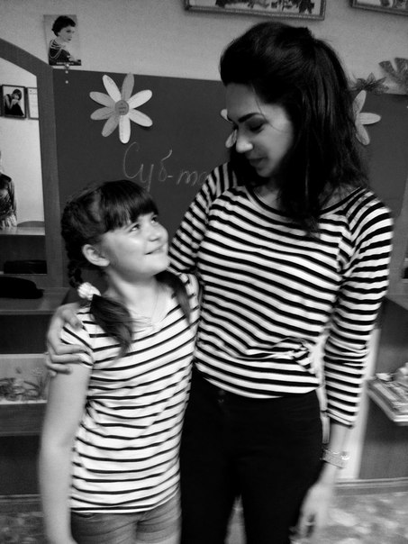
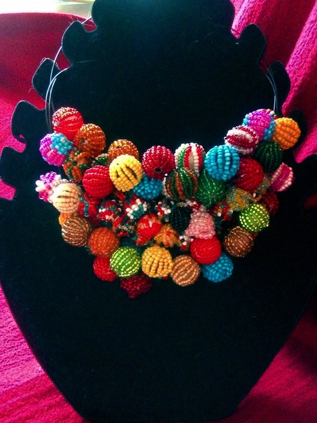
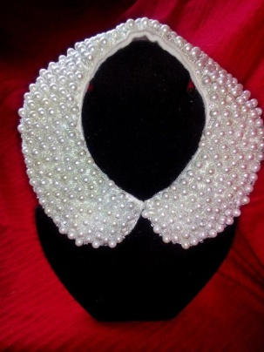
Handmade as medicine for the soul
One day I was bored and I did not know what to do. Suddenly I saw beads. Hardly ever I looked back when in the evening a ready necklace was in my hands. Hands seem to know what to do and how to do and they didn’t even consult with the head. It was how my creative work began since that moment. Like any girl I have always wanted to be beautiful. As we know beauty is in the details. So, it is always necessary for girls to think about their look in details. I think it's very pleasant to realize that you wear things which you have done yourself. So, Hand-made is a very useful activity. It seems to me every girl knows how to sew, knit, sculpt, or at least something from this list.
So, dear girls, create beauty within yourself, for yourself and around you!

Slide 14
Work and Travel USA
Work and Travel USA is a program of international cultural exchange that allows students from different countries of the world to depart to the United States to work and travel on summer vacations. The primary purpose of the program is to acquaint foreign students with the culture and life of modern America and the sharing of other cultures with local inhabitants.
The founder of the program and its main supervisor is the Department of State, which determines the number of students that have a right to take part each year. Companies that represent the program abroad register students in the program, and help to provide information and get the necessary documents. Also some agencies help program participants to plan their journey to their future place of work, giving the possibility of purchasing international airline tickets on students tariffs.

